Slide 1
Activity 01: Data Cleaning & Visuals
SISMID Lab
July 22 through July 24, 2026
A Human – AI Teaming Approach to Infectious Disease Modeling

Slide 2
Lecture Overview
Topic | Slides
1. General Housekeeping | 3
2. Lab Timeline | 4
3. Task Overviews | 5
4. Goal Output | 6
5. Data Cleaning: The Rules | 7–11
6. Activity: Data Cleaning | 12–13
7. Reference Files: agents.md & R Scripts | 14–16
8. Results: Epicurve & Dataset | 17–18

Slide 3

General Housekeeping
Any slide with this icon contains the overview and
expected outputs for the included tasks. All outputs listed on these slides should be uploaded to the course GitHub repository for review.
Any slide with this icon indicates that it is time to complete a hands-on activity. Carefully follow the instructions provided, complete the required task, and verify your results.

Slide 4
Lab Timeline
We are here
Activity 1
Activity 2
Activity 3
Activity 4
Data Cleaning &
Visuals
Data
Exploration
Modeling & Forecasting
Evaluation
Activity 5 Incremental Revisions

Slide 5
Task Overviews
Task | Description
Task 1: Confirm your data | Open the project folder and check it contains the Weekly Hospital Respiratory Data (HRD) Metrics by Jurisdiction.csv dataset.
Task 2: Review the rules | Open rules.md and confirm the Data Cleaning Rules match those covered in the lecture.
Task 3: Create agents.md | Prompt Copilot (or your AI of choice) to turn the rules document into an agents.md file.
Task 4: Build the cleaning script | Use agents.md with Copilot (or your AI of choice) to generate the scripts/01_cleaning.R script.
Task 5: Run & verify output | Run the script and confirm the cleaned CSV has three columns — week, location, value — and produces the epicurve.

Slide 6
Goal Output
From the activity (see previous slide), you should produce your own cleaned dataset and an epicurve visualization. Guided by your data-cleaning rules, an AI agent turns the raw Weekly HRD Metrics file into a tidy three-column dataset and the epidemic curve that summarizes it.
Activity Output | Description
cleaned_flu_admissions.csv | A tidy dataset with three columns — week, location, and value — output by the cleaning script.
Epicurve | An epidemic curve plotting the cleaned weekly admissions, summarizing the data visually.

Slide 7
Data Cleaning: The Rules
These rules are provided in the rules.md file. Your agent will follow them to generate 01_cleaning.R.
1
Load the data
2
Filter to US only
Read the Weekly Hospital Respiratory Data (HRD) Metrics by Jurisdiction.csv from the data/ folder using readr.
Column: 'Geographic aggregation' → keep rows where value is "USA".
3
Select target column
4
Reshape to 3 cols
Keep only the `Total Influenza Admissions` column. Drop all other columns, including those for RSV and COVID-19.
Rename and restructure the data to: week, location ("US"), value.
5
Format dates
6
Save output
Convert week ending date to R Date object. Sort ascending.
Write cleaned_flu_admissions.csv and the epicurve to the appropriate subfolder in output/.

Slide 8


Reminder: Rules Document vs AI Agent
rules.md
agents.md
AI
generates
Written by YOU
Generated by AI
Human-readable specifications
Describes WHAT the pipeline should do
You edit this to improve results
AI-readable agent instructions
Describes HOW to execute the pipeline
The intermediary between you and code
At the end of the day, you are still the expert making the decisions.

Slide 9
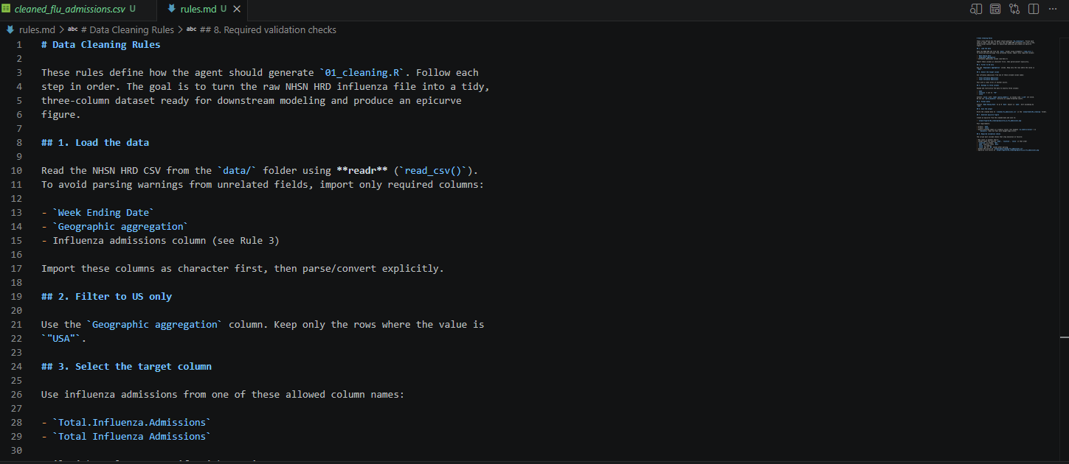
rules.md Starting Place
We do not need to make any changes to the rules.md file for this activity. During future activities, we will be adding our own rules to this document and re-generating the agents.md file. For now, this is included as an example of how to structure the rules document as we build it up.

Slide 10
Prompting Your Agent
This activity will require two prompts: One to build the agent and one to generate code.
Step 1: Generate the agent
Using rules.md, generate an agent file and save as agents.md
Step 2: Generate the R script
Using agents.md, generate a Data Cleaning script and save as scripts/01_cleaning.R
The rules doc is what YOU control. The agent is what the AI builds from it. The scripts are what the agent produces.
Notes:
Mention hallucinations

Slide 11
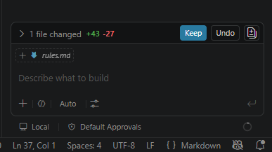
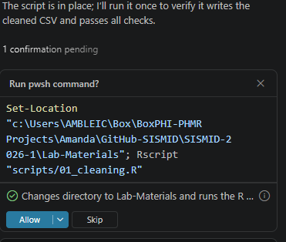
Some Tips
Each time we make a change to a file via the integrated AI, the changes made from file version to file version are tracked. Each time you make a change, you will want to see what the AI did, and if happy with the change, click Keep. This will change the file in your working directory to match that with the changes made by the AI.
The AI may try to run the code directly within the chat window. This can be buggy at times, so we suggest skipping this suggestion and running locally (via the editor window). If you decide to run via the chat window, you may be given a series of prompts until R is found on your local machine. To skip and run locally, click Skip.

Slide 12
Now it’s your turn!
Together, we will work through Tasks 1 through 5 to create the agents.md file & data cleaning script, as well as prepare the data and get the epicurve.
1
Open the project folder and double check that it contains data/Weekly Hospital Respiratory Data (HRD) Metrics by Jurisdiction.csv
2
Open the rules.md file and read Data Cleaning Rules. Make sure all rules match those specified on the earlier slide. If you have any questions, please let us know.
3
Prompt Copilot (or your AI of choice) to generate the agents.md file from the rules document (Hint: copy the Step 1 prompt from Slide 9).
4
Use the agents.md file and Copilot (or your AI of choice) to generate scripts/01_cleaning.R (Hint: copy the Step 2 prompt from Slide 9).
5
Run the script, check the output CSV has 3 columns: week, location, value and you have the epicurve of the data.

Slide 13
Expected Process & Results

Slide 14
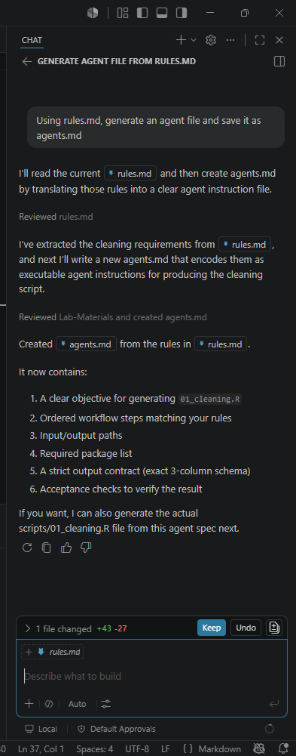
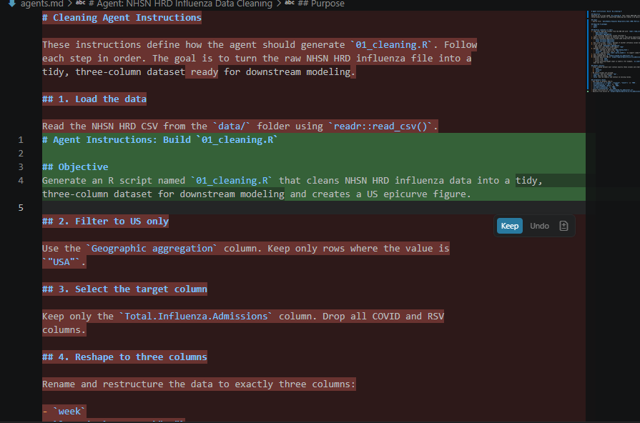
agents.md File

Slide 15
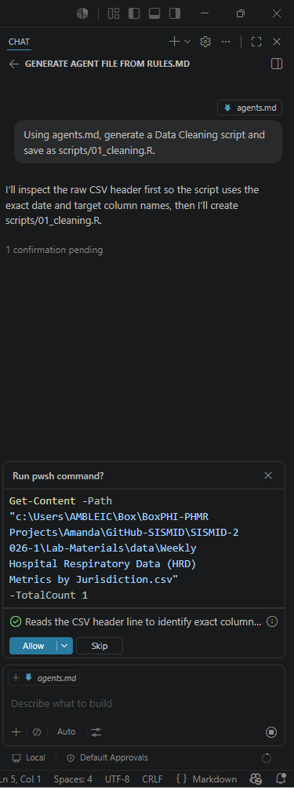
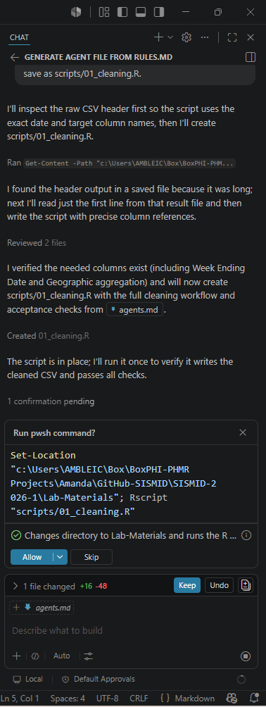
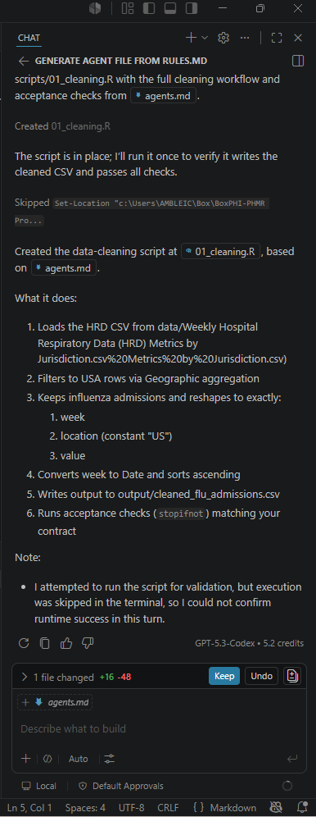
R Script
When generating the 01_cleaning.R script, the AI may prompt you multiple times at many steps from your initial message to the script.
For example, in the initial picture, it is asking permission to look at the data. In the second picture, it is asking permission to run the script (Skipped for this activity; see earlier slide).
The key is to read WHY you are being asked a question before clicking Allow or Keep.

Slide 16
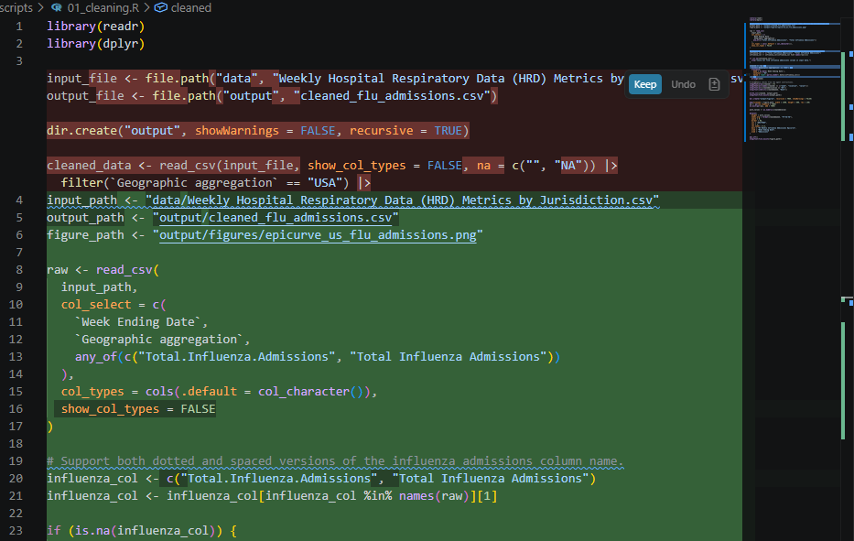
01_cleaning.R File

Slide 17
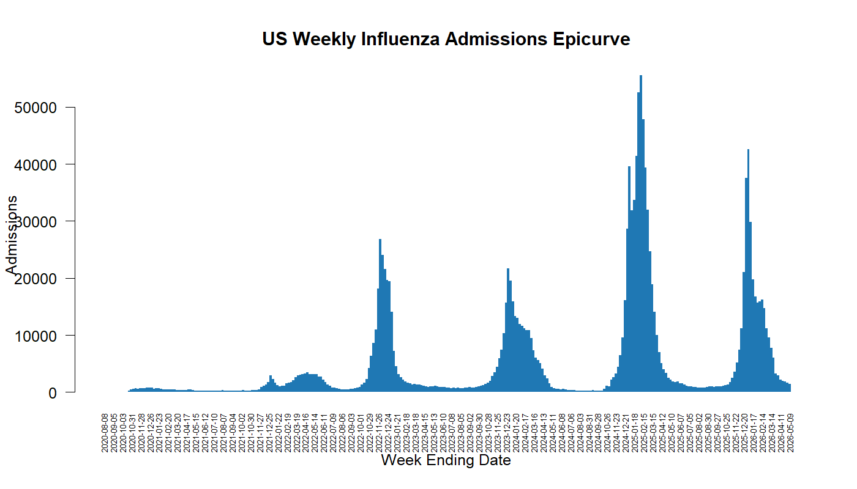
Resulting Epicurve

Slide 18
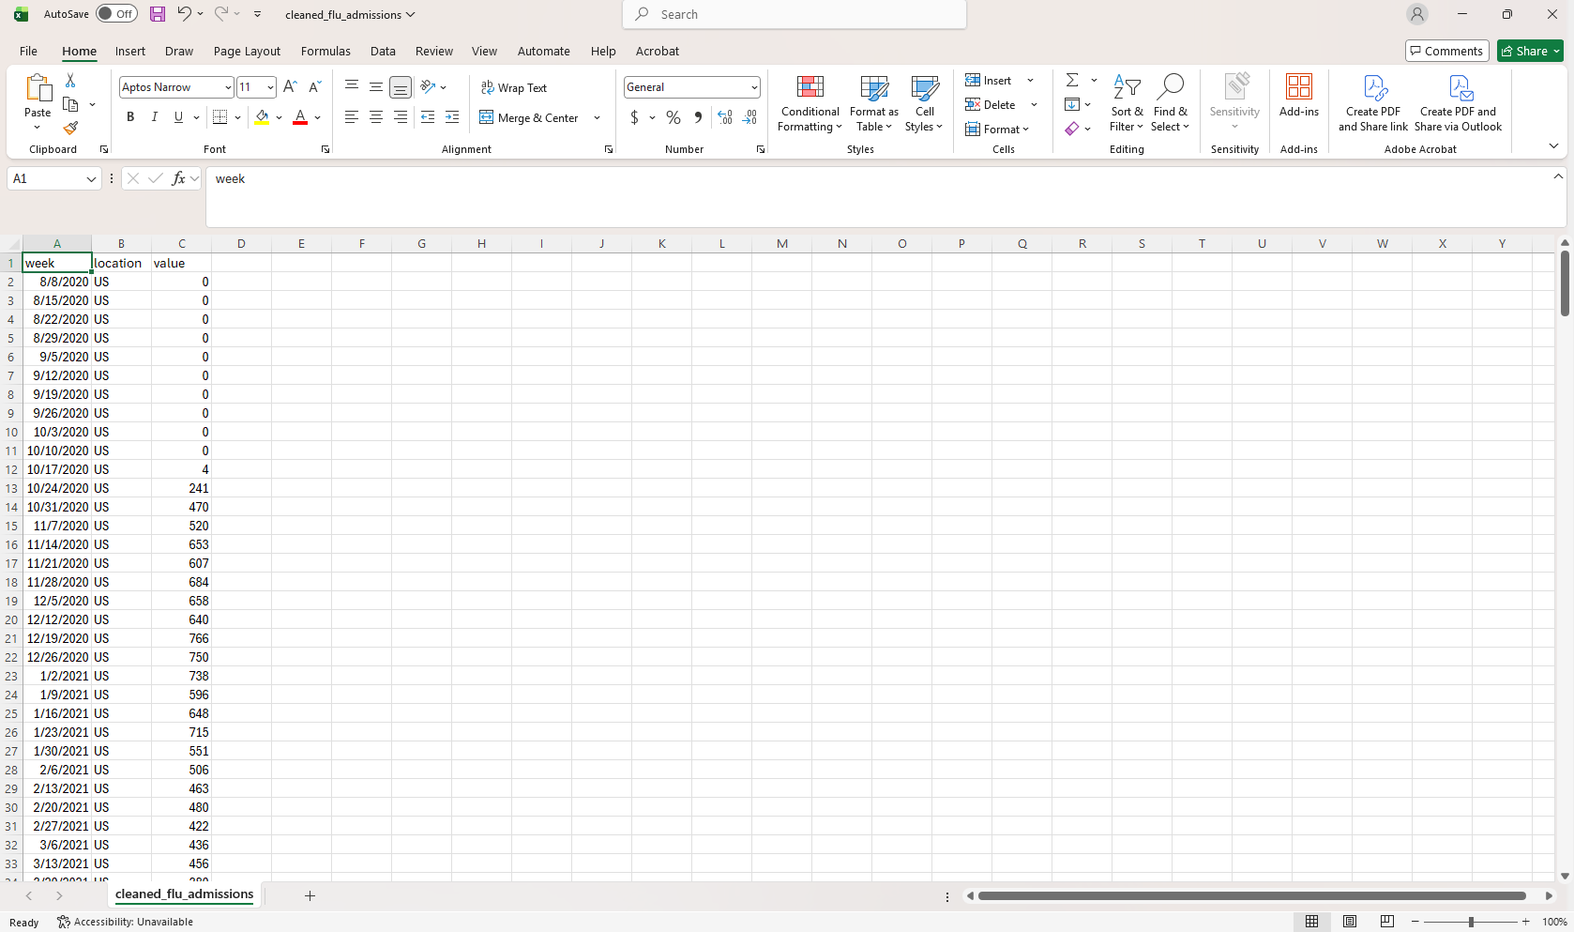
Resulting Dataset: cleaned_flu_admissions.csv

